Slide 1
OSI Physical Layer
Network Fundamentals – Chapter 8

Slide 2
Objectives
Explain the role of Physical layer protocols and services in supporting communication across data networks.
Describe the role of signals used to represent bits as a frame as the frame is transported across the local media.
Describe the purpose of Physical layer signaling and encoding as they are used in networks.
Identify the basic characteristics of copper, fiber and wireless network media.
Describe common uses of copper, fiber and wireless network media.

Slide 3
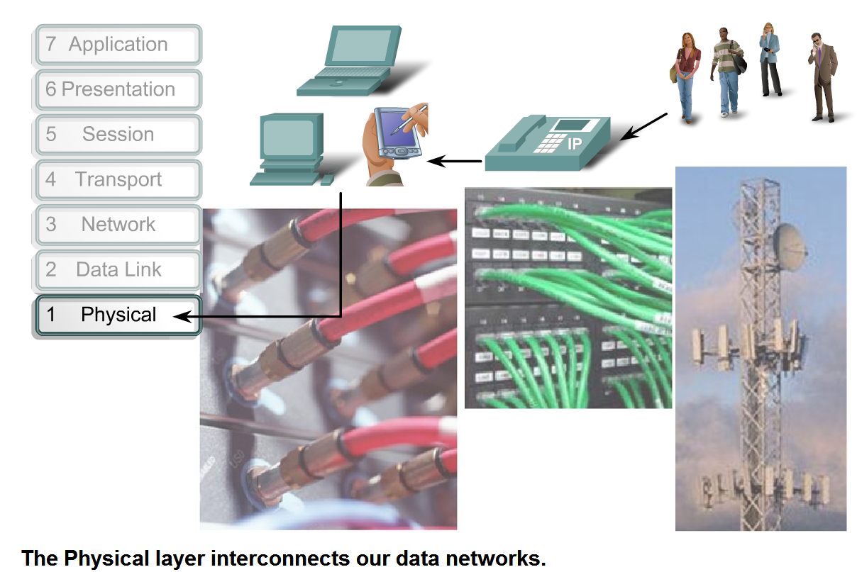
Physical Layer Protocols & Services
Describe the purpose of the Physical layer in the network and identify the basic elements that enable this layer to fulfill its function

Slide 4
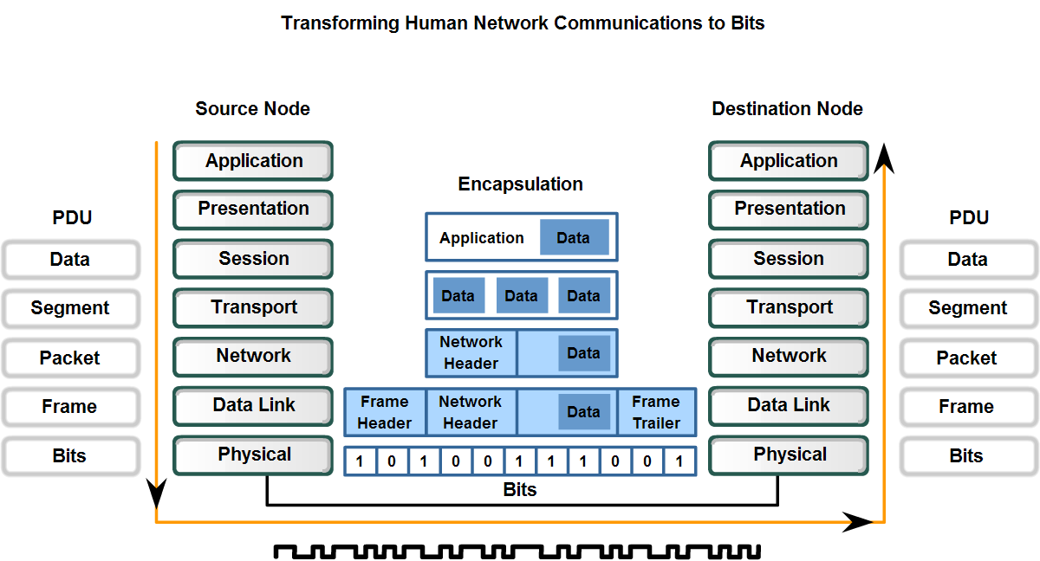
Physical Layer Protocols & Services
Describe the role of bits in representing a frame as it is transported across the local media

Slide 5
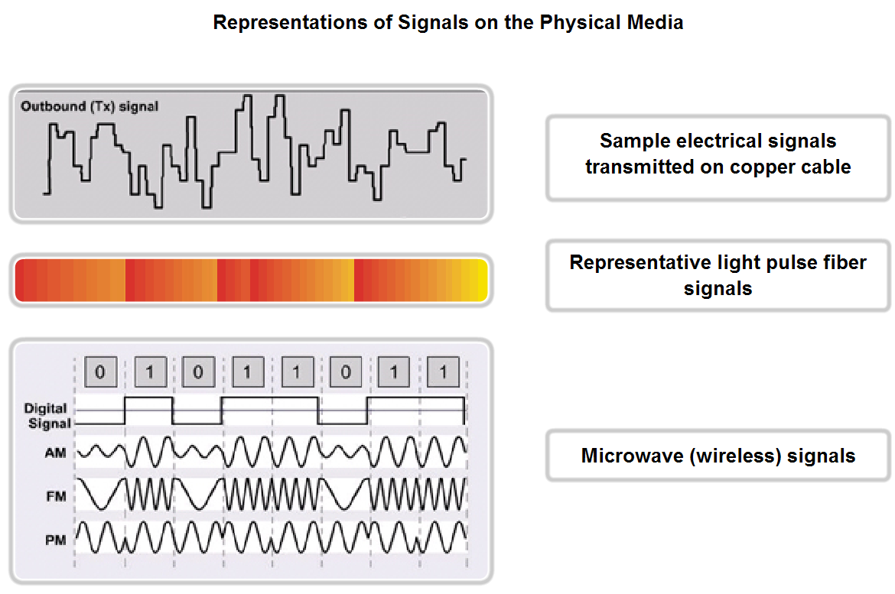
Physical Layer Protocols & Services
Describe the role of signaling in the physical media

Slide 6
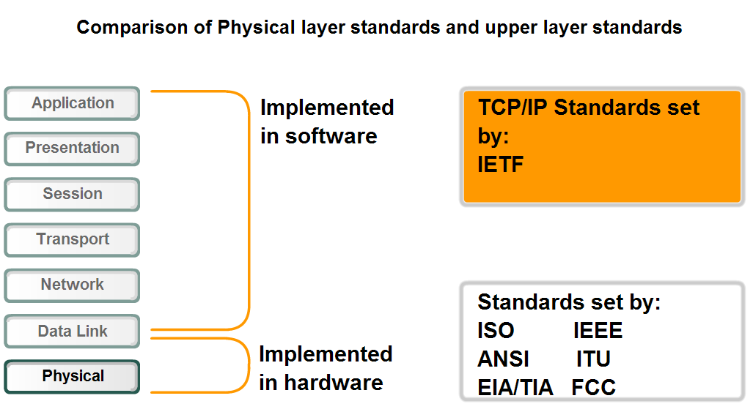
Physical Layer Protocols & Services
Distinguish who establishes and maintains standards for the Physical layers compared to those for the other layers of the network

Slide 7
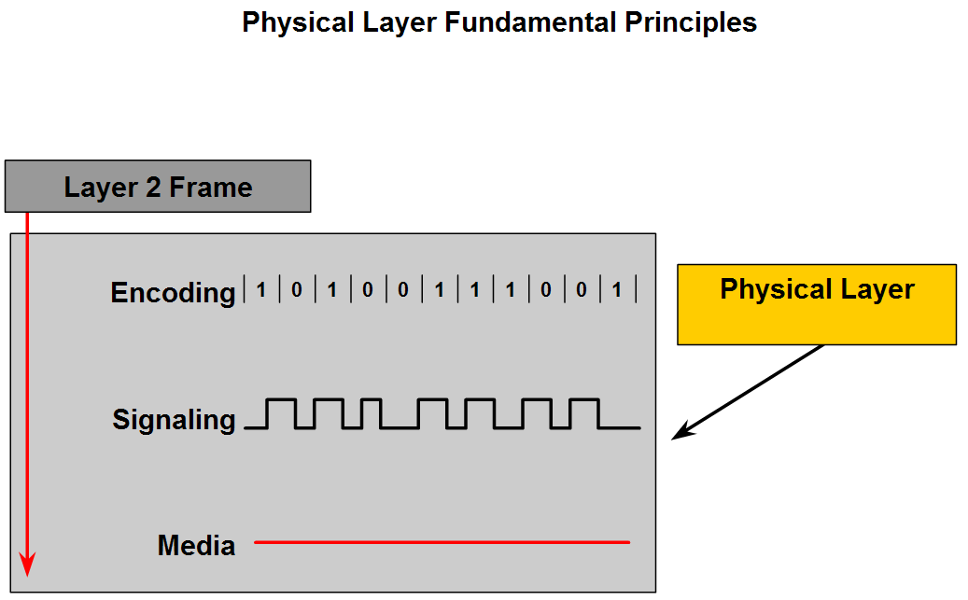
Physical Layer Protocols & Services
Identify hardware components associated with the Physical layer that are governed by standards

Slide 8
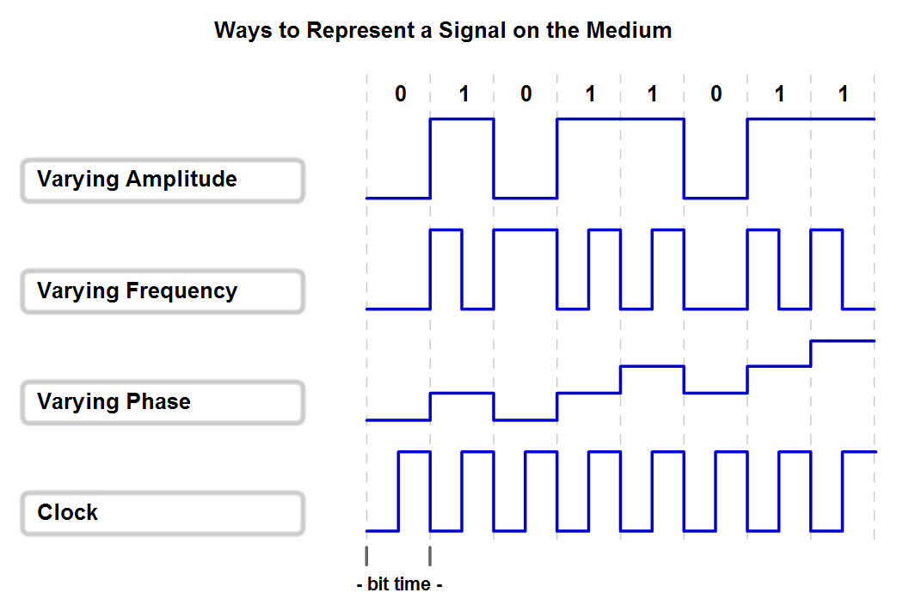
Physical Layer Signaling and Encoding
Explain that network communication at this layer consists of individual bits encoded onto the Physical layer and describe the basic encoding techniques

Slide 9
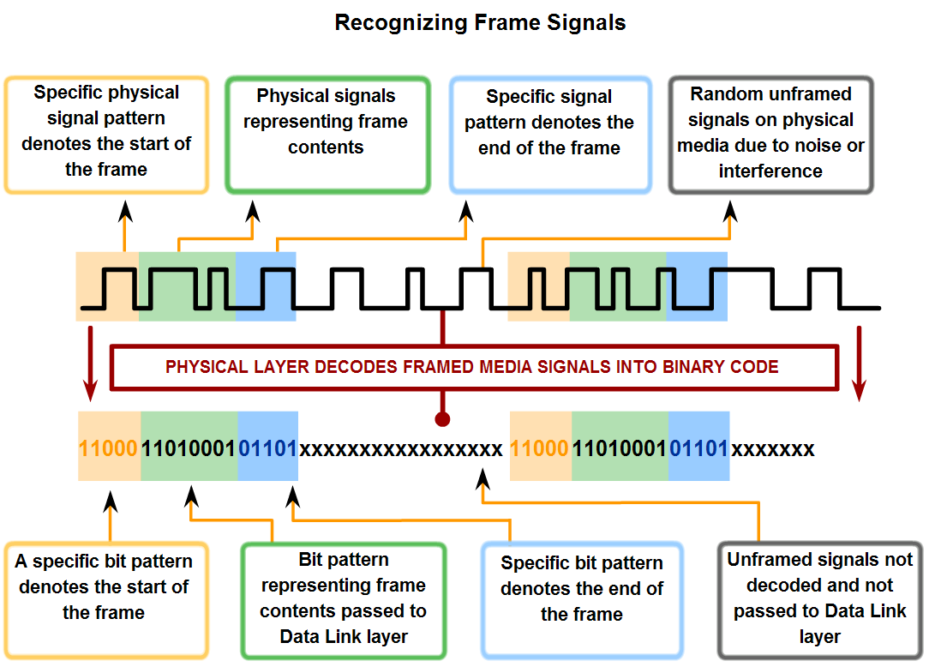
Physical Layer Signaling and Encoding
Describe the role of encoding as it applies to the transmission of bits and explain the value of treating a collection of bits as a code

Slide 10
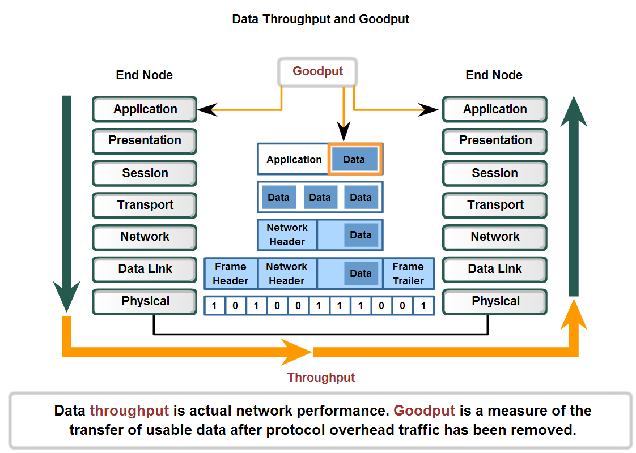
Physical Layer Signaling and Encoding
Define the terms bandwidth, throughput, and goodput

Slide 11
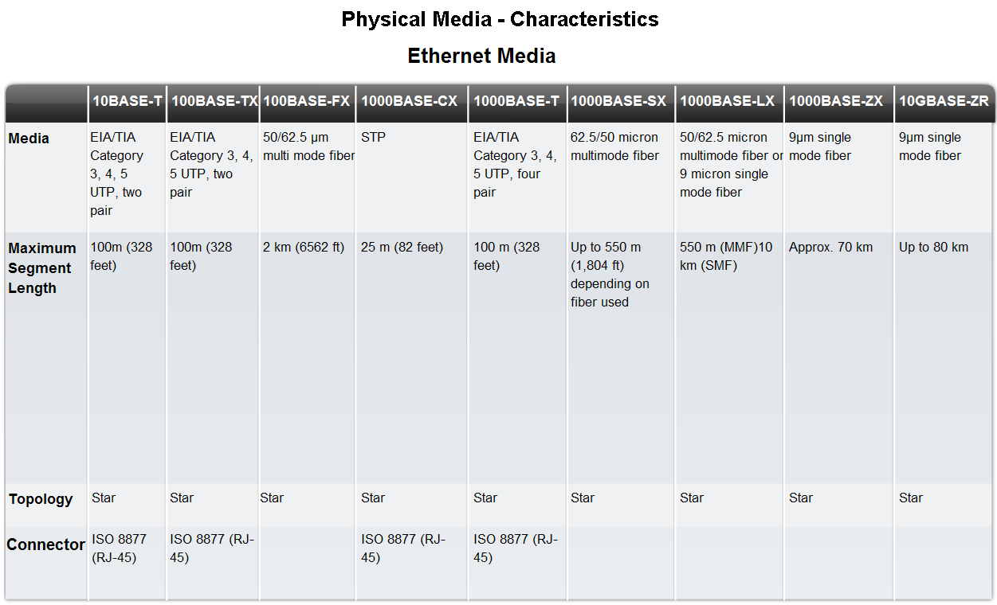
Characteristics & Uses of Network Media
Identify several media characteristics defined by Physical layer standards

Slide 12
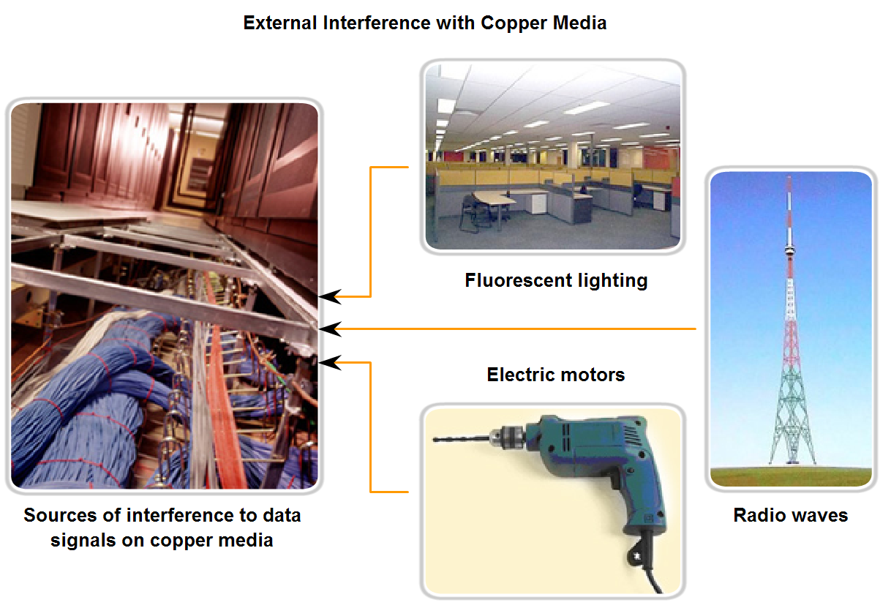
Characteristics & Uses of Network Media
Describe the impact interference has on throughput and the role of proper cabling in reducing interference

Slide 13
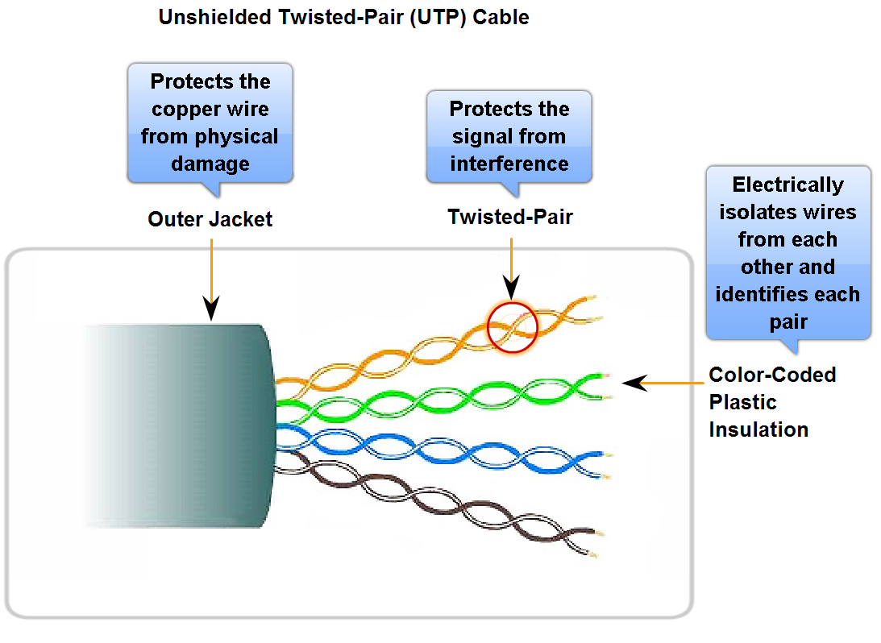
Characteristics & Uses of Network Media
Identify the basic characteristics of UTP cable

Slide 14
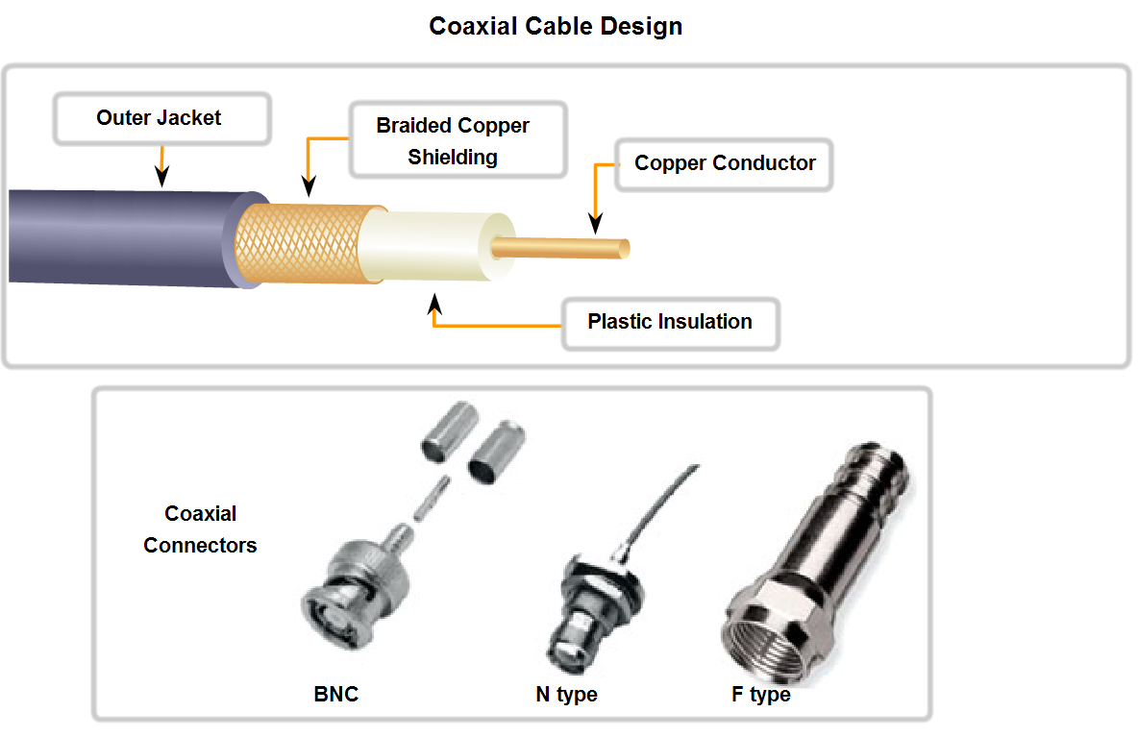
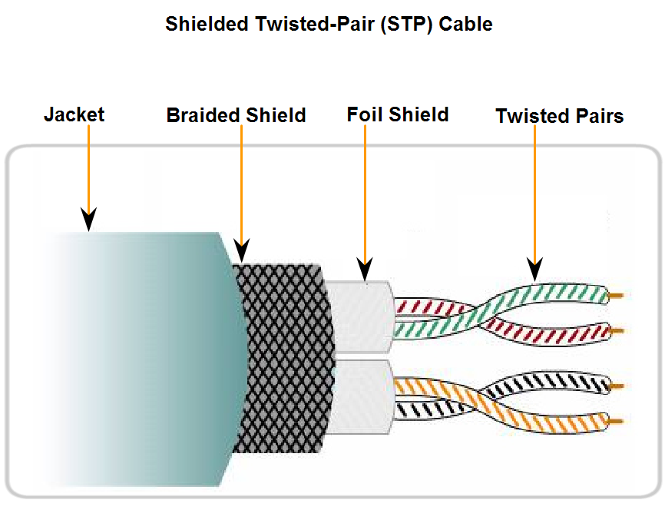
Characteristics & Uses of Network Media
Identify the basic characteristics of STP and Coaxial cable

Slide 15
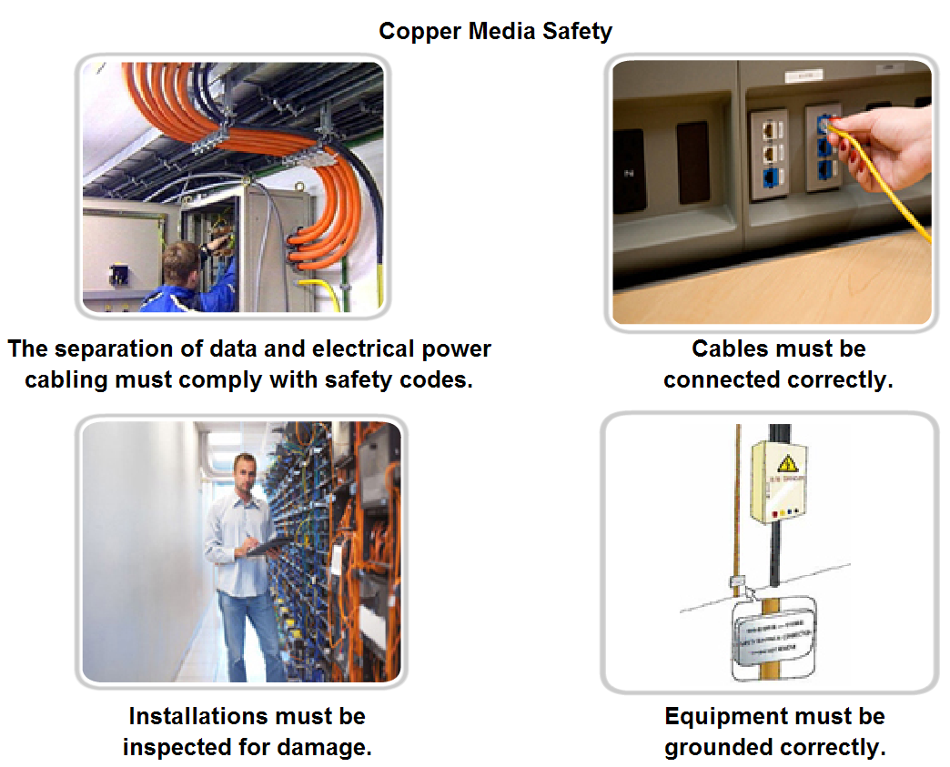
Characteristics & Uses of Network Media
Identify types of safety issues when working with copper cabling

Slide 16
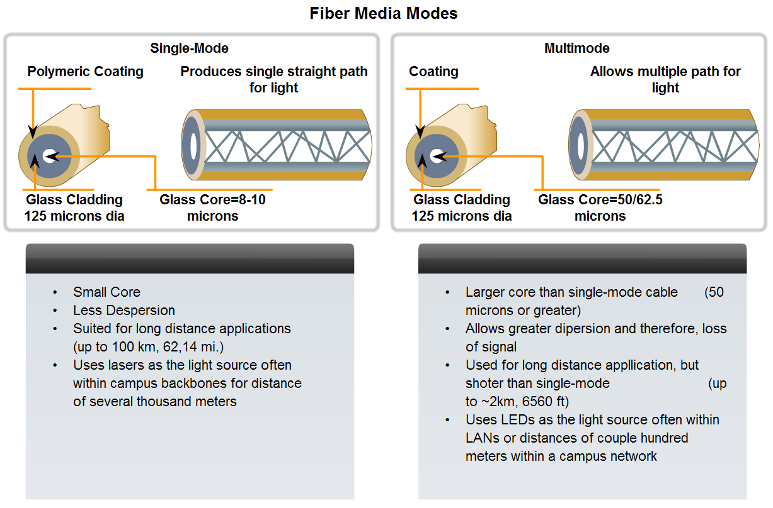
Characteristics & Uses of Network Media
Identify several primary characteristics of fiber cabling and its main advantages over other media

Slide 17
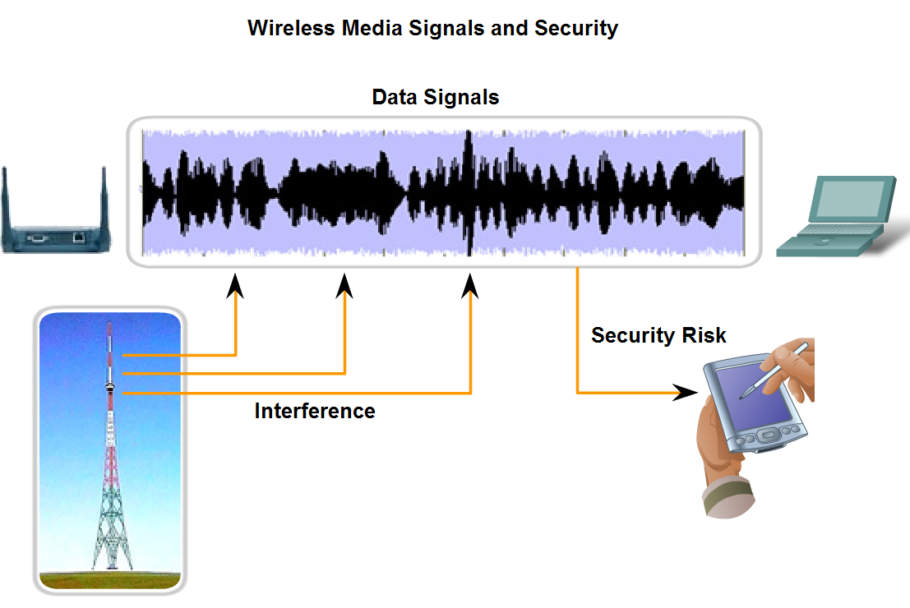
Characteristics & Uses of Network Media
Describe the role of radio waves when using air as the media and the increased need for security in wireless communications

Slide 18
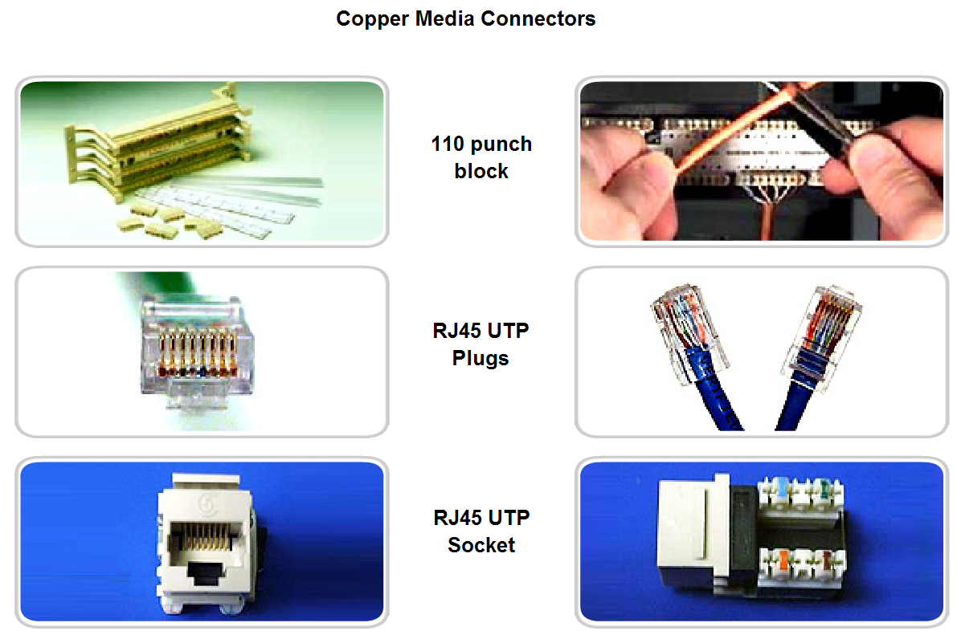
Characteristics & Uses of Network Media
Identify the characteristics used to categorize connectors, describe some common uses for the same connectors, and identify the consequences for misapplying a connector in a given situation

Slide 19
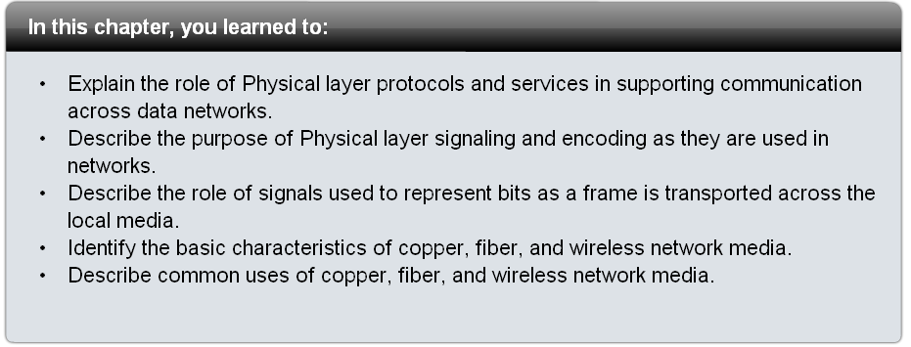
Summary

